Slide 1
TOGAF 9 - Core Diagrams Business Services and Information Diagram Phase B – Business Architecture

Slide 2
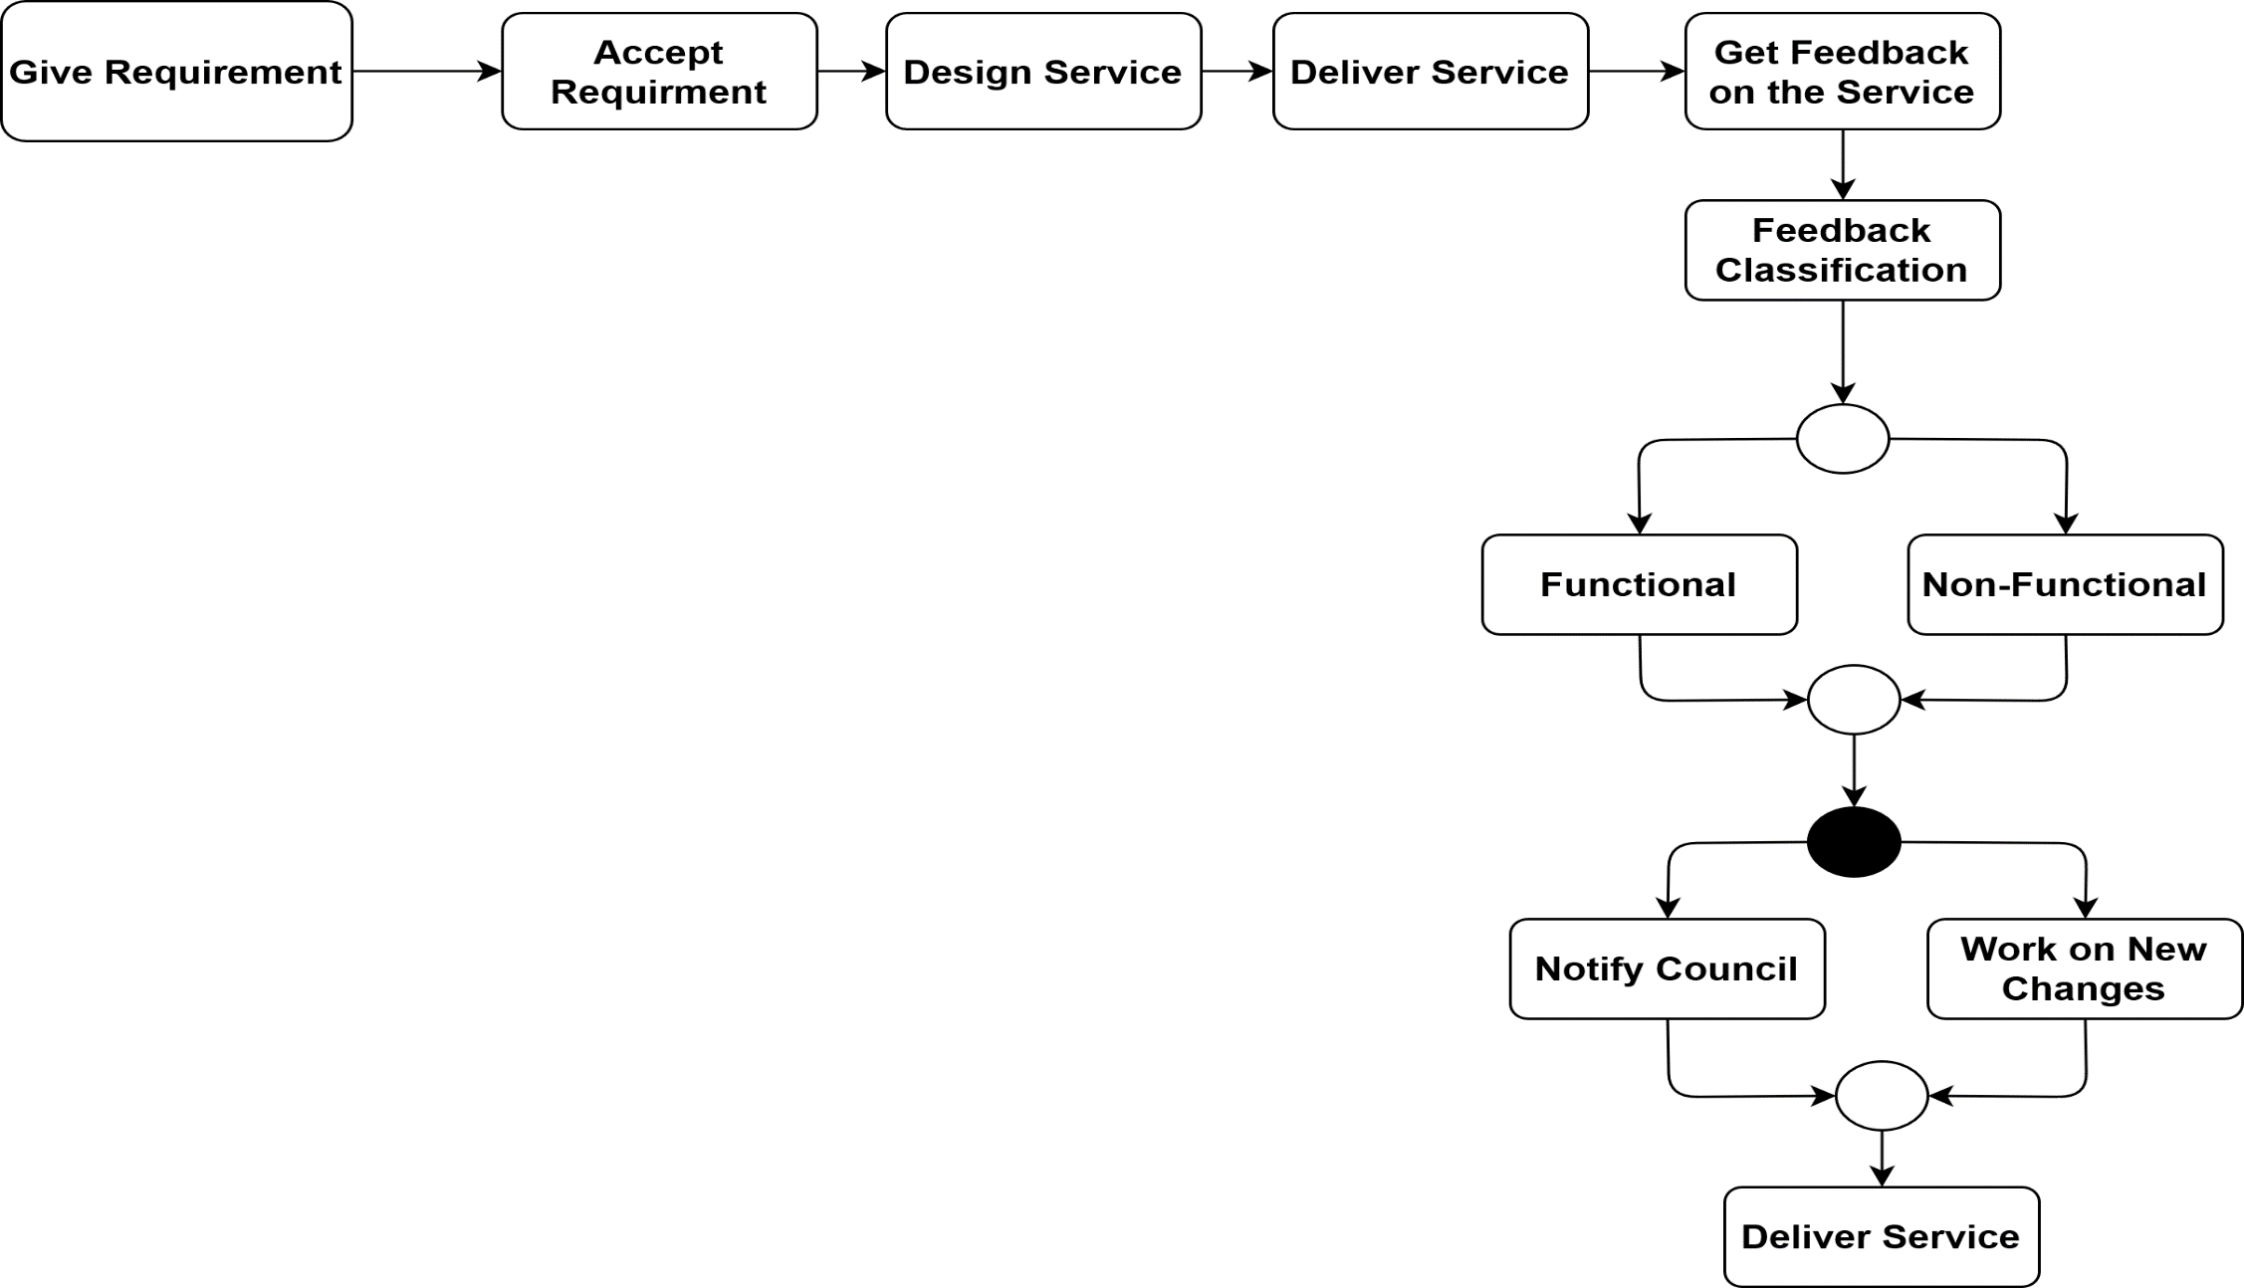
Business Services and Information Diagram
Service Design Process with citizens Engagement

Slide 3
Example: E-parking Services in Ireland
Service Provider | ParkMagic
Users | Citizens of the city
City | Cork, Limerick, Mayo
Service Name | E-parking service
Feedback Platform | Apps for Android and Apple users
App Names | Limerick e-parking, Cork Park By Phone, Mayo E-Parking
Form of Feedback | Online Review
Classification of the Reviews | Functional for instance issues with the registration process, App not responding properly. Non-functional for instance additional €1.00 service charge on each top-up.

